Slide 1
Introduction to ROOT
CODAC@iter.org
May 4 2010
Rene Brun/CERN

Slide 2
High Energy Physics
About 10000 physicists in the HEP domain distributed in a few hundred universities/labs
About 7000 involved in the CERN LHC program
  ATLAS : 2900
  CMS : 2700
  ALICE: 1200
  LHCb : 600

Slide 3
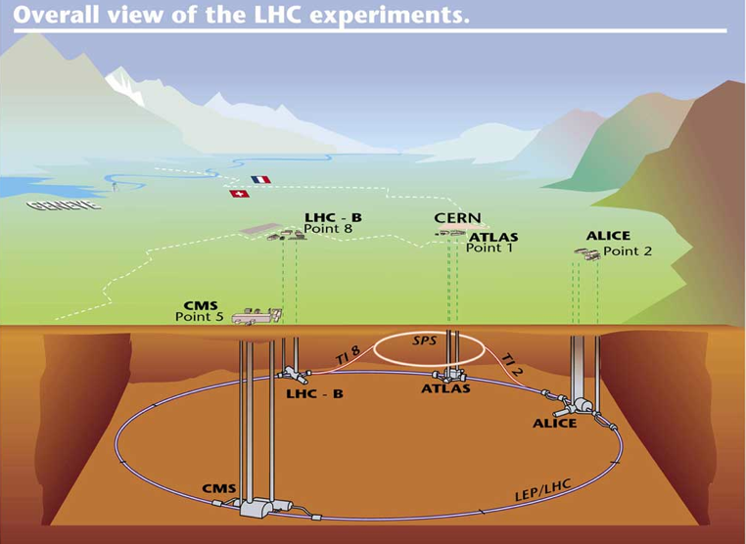
LHC

Slide 4
HEP environment
In the following slides I will discuss mainly the LHC data bases, but the situation is quasi identical in all other labs in HEP and Nuclear Physics labs too.
A growing number of AstroPhysics experiments is following a similar model.
HEP tools also used in Biology, Finance, Oil industry, car makers, etc

Slide 5
LHC expts data flow

Slide 6
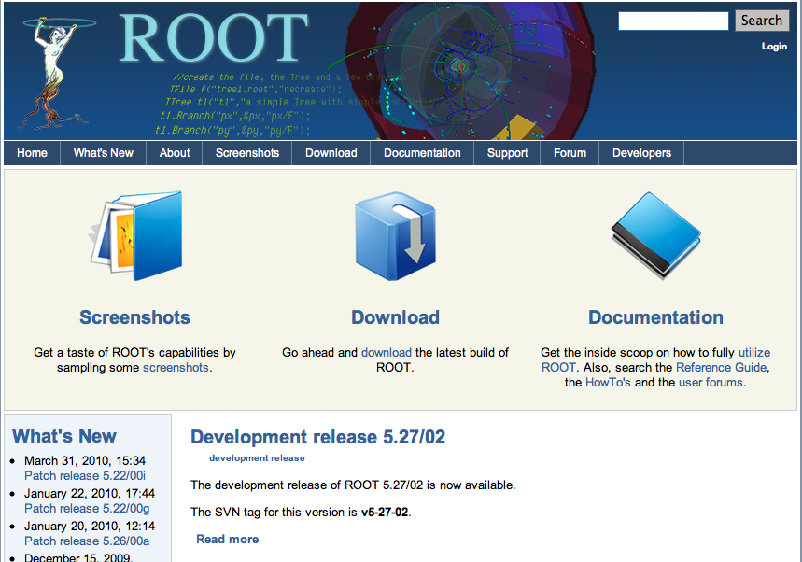
http://root.cern.ch

Slide 7
ROOT in a nutshell
An efficient data storage and access system designed to support structured data sets in very large distributed data bases (Petabytes).
A query system to extract information from these distributed data sets.
The query system is able to use transparently parallel systems on the GRID (PROOF).
A scientific visualisation system with 2-D and 3-D graphics.
An advanced Graphical User Interface
A C++ interpreter allowing calls to user defined classes.
An Open Source Project

Slide 8
ROOT: An Open Source Project
The project is developed as a collaboration between :
Full time developers:
  8 people full time at CERN
  2 developers at FermiLab (Chicago)
Many contributors spending a substantial fraction of their time in specific areas (> 50).
Key developers in large experiments using ROOT as a framework.
Several thousand users given feedback and a very long list of small contributions.

Slide 9
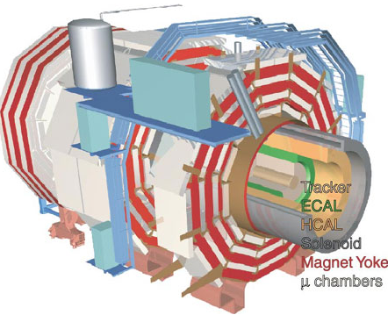
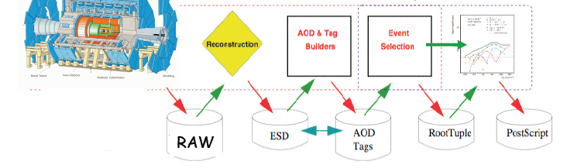
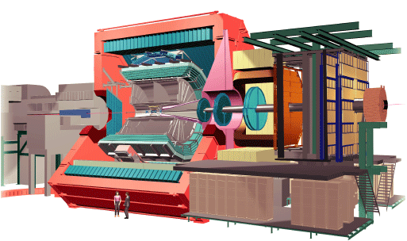
ROOT Application Domains
Data Analysis & Visualization
General Framework
Data Storage: Local, Network

Slide 10
ROOT: a Framework and a Library
User classes
  User can define new classes interactively
  Either using calling API or sub-classing API
  These classes can inherit from ROOT classes
Dynamic linking
  Interpreted code can call compiled code
  Compiled code can call interpreted code
  Macros can be dynamically compiled & linked
This is the normal
operation mode
Interesting feature
for GUIs &
event displays
Script Compiler
root > .x file.C++

Slide 11
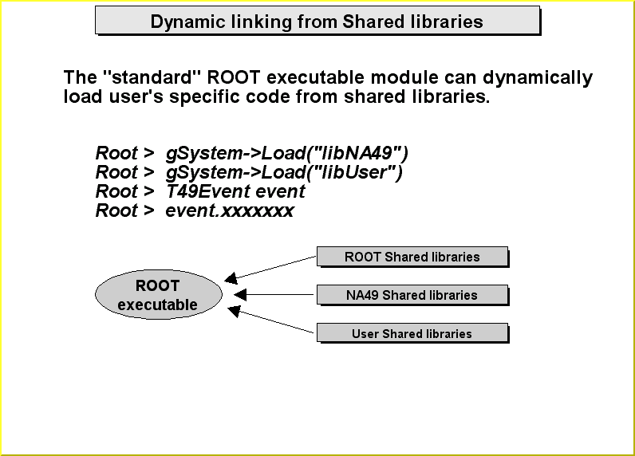
Dynamic Linking
A Shared Library can be linked dynamically to a running executable module
either via explicit loading,
- or automatically via plug-in manager
Experiment
libraries
A Shared Library facilitates the development and maintenance phases
User
libraries
General
libraries
Application
Executable Module

Slide 12
Plug-in Manager
User Shared lib
Exp Shared libs
Exp Shared libs
Exp Shared libs
Basic Services, GUI, Math..
General Utility
Shared lib
Plug-in manager
I/O manager
Interpreter
I/O manager
Object Dictionary

Slide 13
CINT: the C++ interpreter

Slide 14
My first session
root
root 344+76.8
(const double)4.20800000000000010e+002
root float x=89.7;
root float y=567.8;
root x+sqrt(y)
(double)1.13528550991510710e+002
root float z = x+2*sqrt(y/6);
root z
(float)1.09155929565429690e+002
root .q
root
See file $HOME/.root_hist
root try up and down arrows

Slide 15
My second session
root
root .x session2.C
for N=100000, sum= 45908.6
root sum
(double)4.59085828512453370e+004
root r.Rndm()
(Double_t)8.29029321670533560e-001
root .q
session2.C
{
int N = 100000;
TRandom r;
double sum = 0;
for (int i=0;i<N;i++) {
sum += sin(r.Rndm());
}
printf("for N=%d, sum= %g\n",N,sum);
}
unnamed macro
executes in global scope

Slide 16
My third session
root
root .x session3.C
for N=100000, sum= 45908.6
root sum
Error: Symbol sum is not defined in current scope
*** Interpreter error recovered ***
root .x session3.C(1000)
for N=1000, sum= 460.311
root .q
session3.C
void session3 (int N=100000) {
TRandom r;
double sum = 0;
for (int i=0;i<N;i++) {
sum += sin(r.Rndm());
}
printf("for N=%d, sum= %g\n",N,sum);
}
Named macro
Normal C++ scope rules

Slide 17
My third session with ACLIC
root gROOT->Time();
root .x session4.C(10000000)
for N=10000000, sum= 4.59765e+006
Real time 0:00:06, CP time 6.890
root .x session4.C+(10000000)
for N=10000000, sum= 4.59765e+006
Real time 0:00:09, CP time 1.062
root session4(10000000)
for N=10000000, sum= 4.59765e+006
Real time 0:00:01, CP time 1.052
root .q
session4.C
#include “TRandom.h”
void session4 (int N) {
TRandom r;
double sum = 0;
for (int i=0;i<N;i++) {
sum += sin(r.Rndm());
}
printf("for N=%d, sum= %g\n",N,sum);
}
File session4.C
Automatically compiled and linked by the
native compiler.
Must be C++ compliant

Slide 18
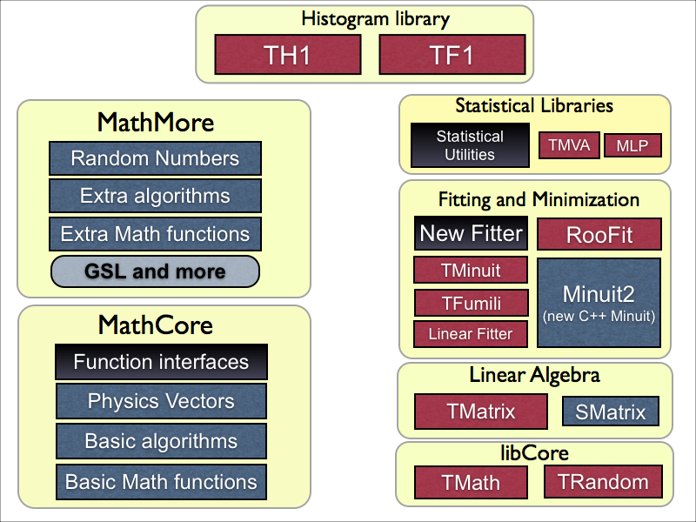
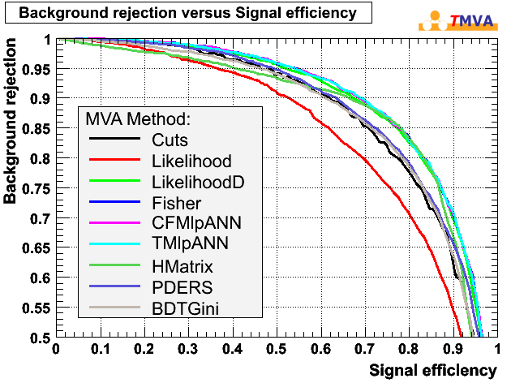
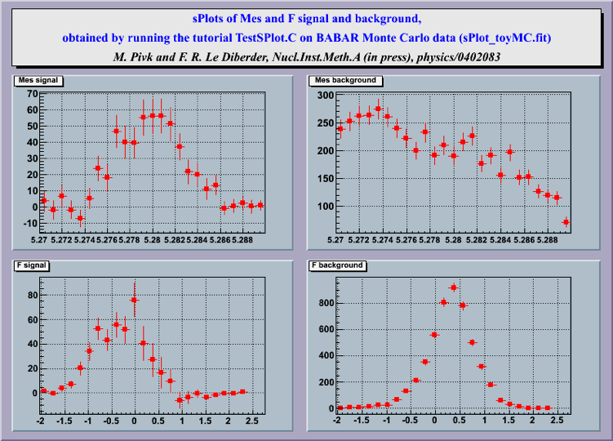
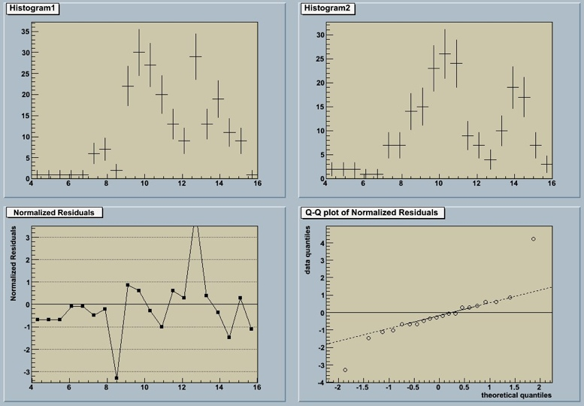
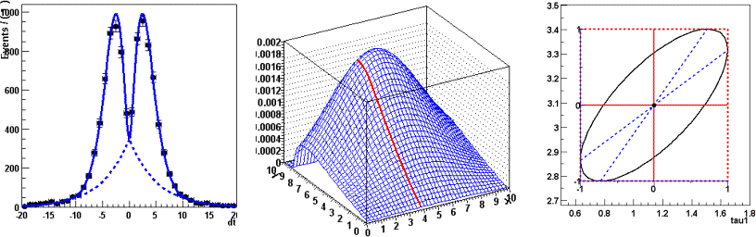
Math Libs
TMVA
SPlot

Slide 19
GUI

Slide 20
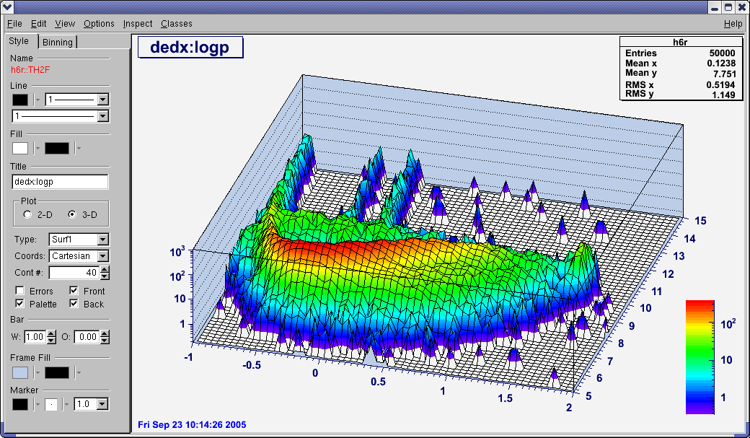
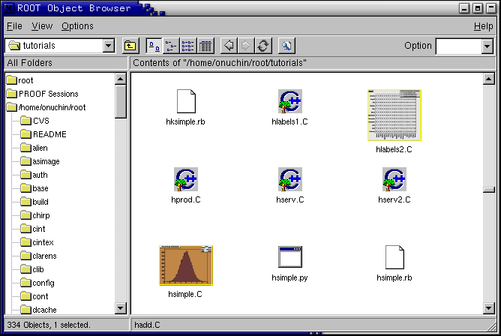
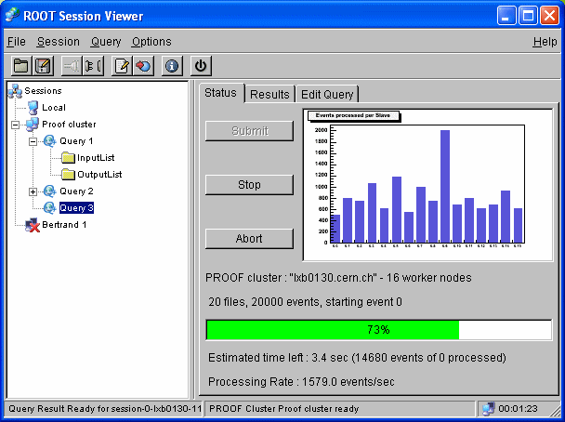
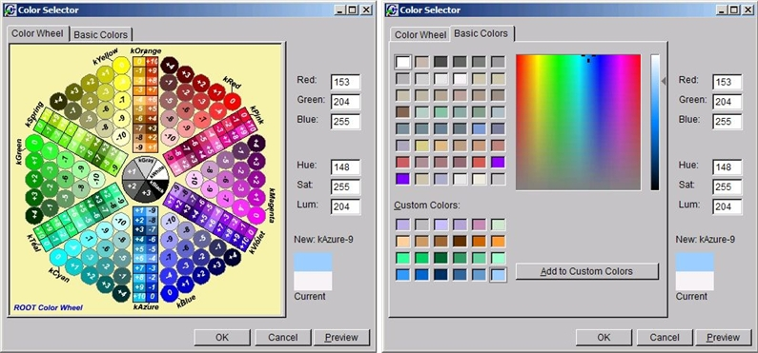
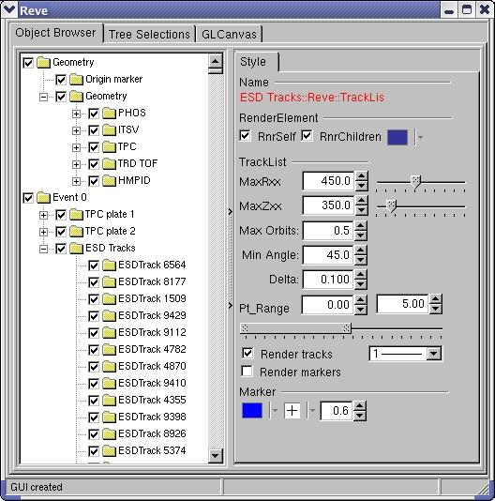
GUI (Graphical User Interface)

Slide 21
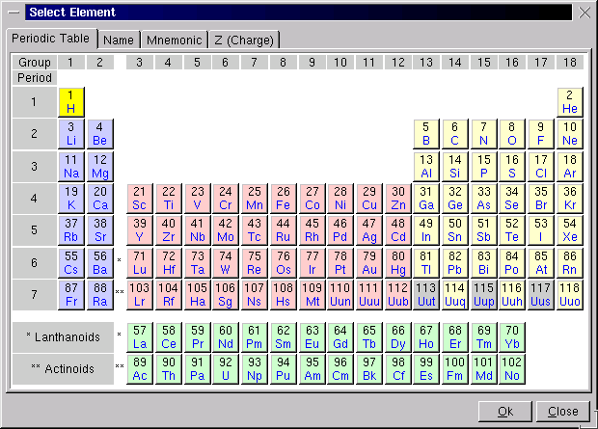
GUI User example
Example of GUI
based on ROOT tools
Each element
is clickable

Slide 22
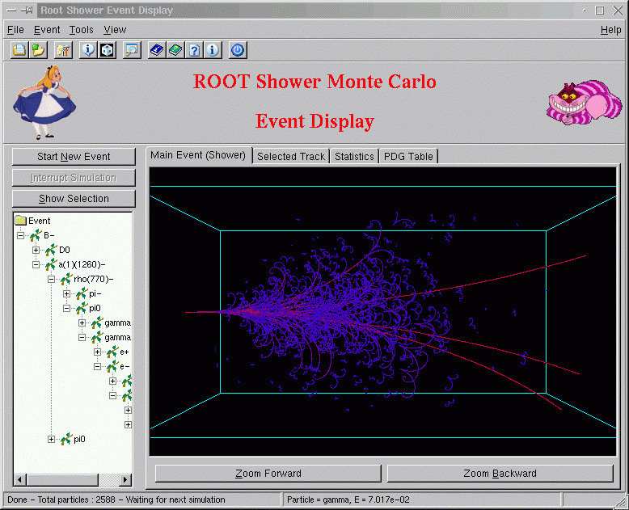
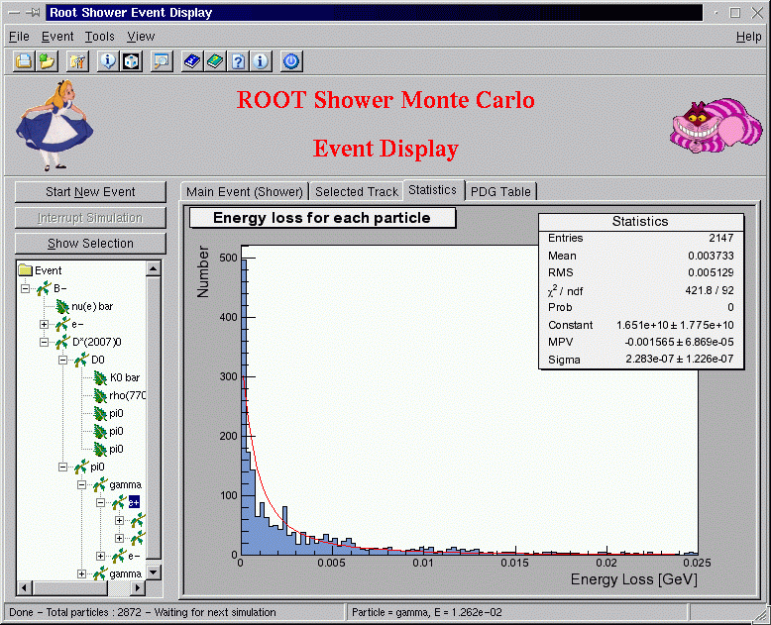
GUI Examples

Slide 23
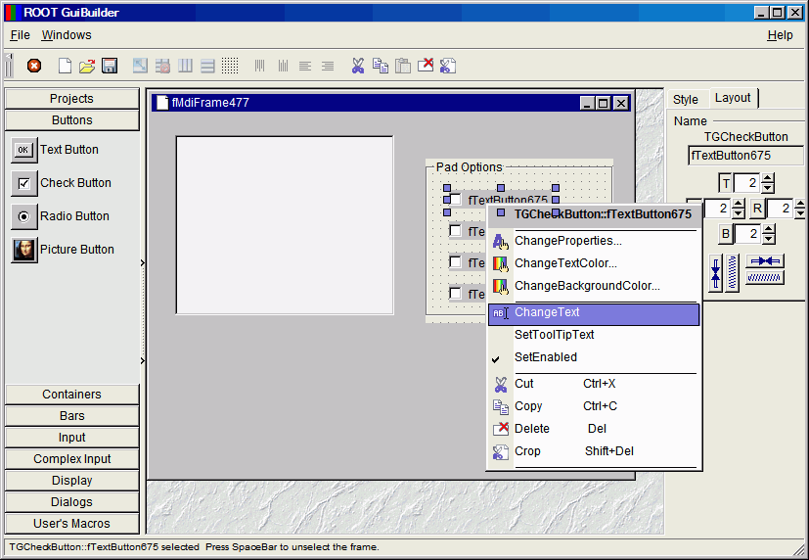
The GUI Builder
The GUI builder provides GUI tools for developing user interfaces based on the ROOT GUI classes. It includes over 30 advanced widgets and an automatic C++ code generator.

Slide 24
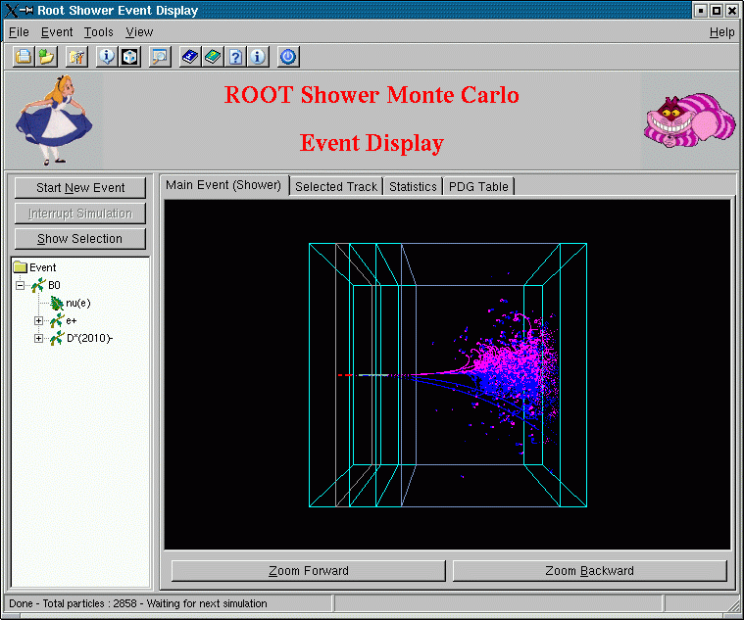
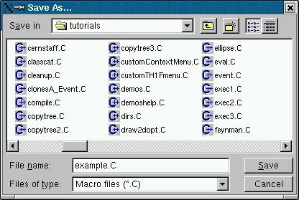

GUI C++ code generator
When pressing ctrl+S on any widget it is saved as a C++ macro file thanks to the SavePrimitive methods implemented in all GUI classes. The generated macro can be edited and then executed via CINT
Executing the macro restores the complete original GUI as well as all created signal/slot connections in a global way
root [0] .x example.C
// transient frame
TGTransientFrame *frame2 = new TGTransientFrame(gClient->GetRoot(),760,590);
// group frame
TGGroupFrame *frame3 = new TGGroupFrame(frame2,"curve");
TGRadioButton *frame4 = new TGRadioButton(frame3,"gaus",10);
frame3->AddFrame(frame4);

Slide 25
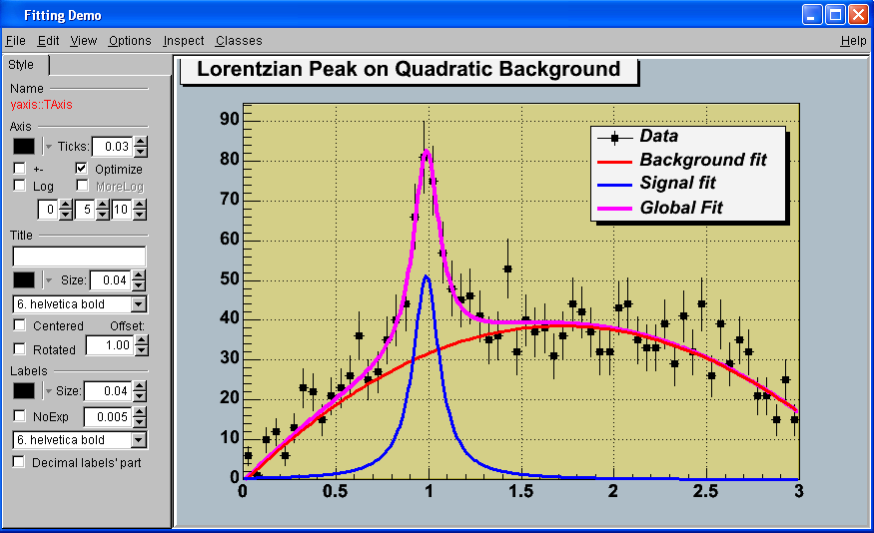
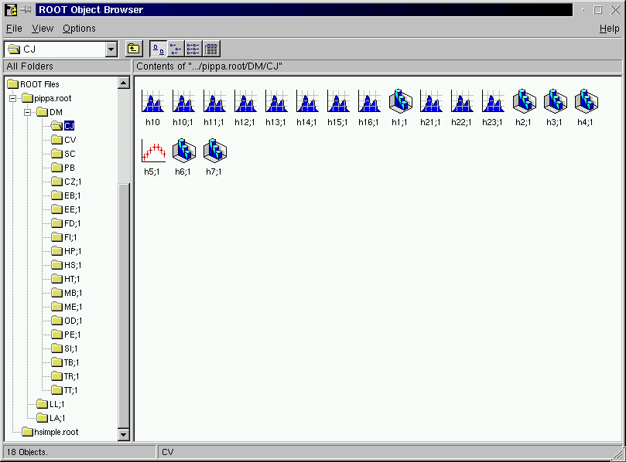
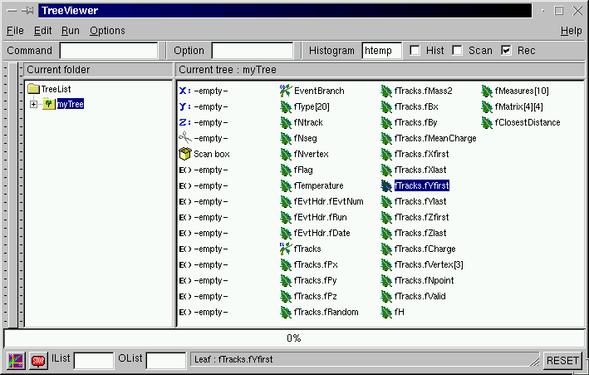
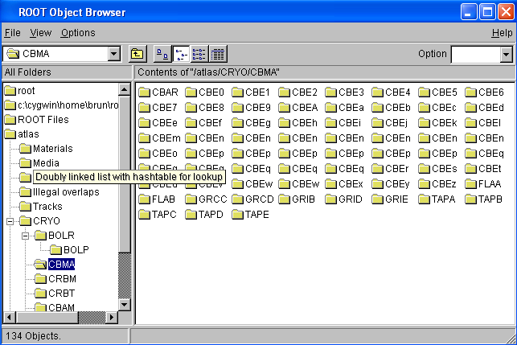
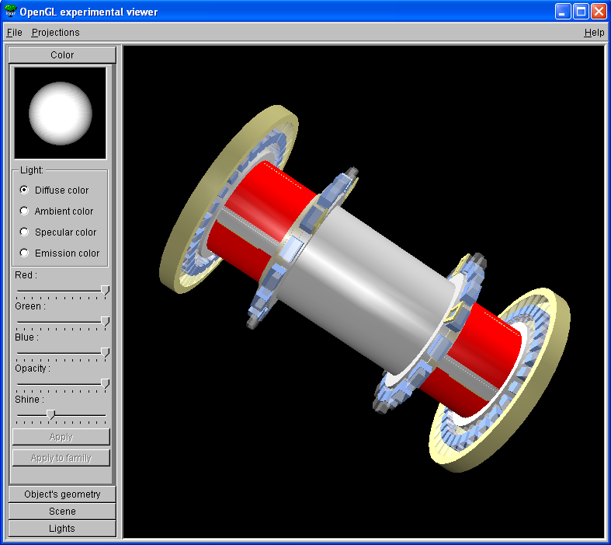
Combining UI and GUI
root .x session2.C
for N=100000, sum= 45908.6
root sum
(double)4.59085828512453370e+004
root r.Rndm()
(Double_t)8.29029321670533560e-001
root .q

Slide 26
Graphics

Slide 27
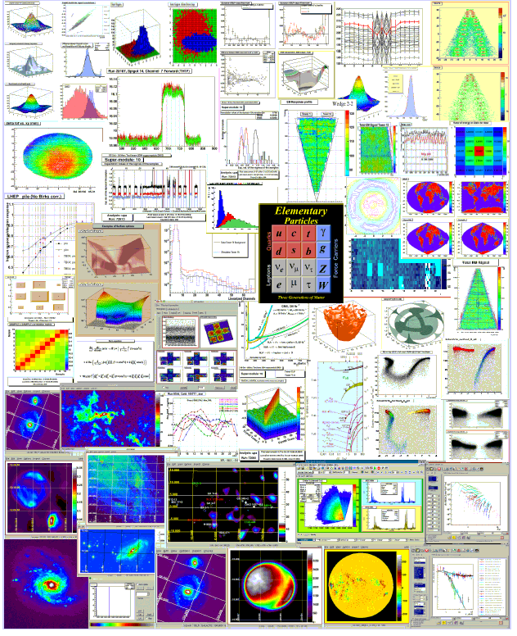
2-D Graphics
New functions added at each new release.
Always new requests for new styles, coordinate systems.
ps,pdf,svg,gif,
jpg,png,c,root, etc

Slide 28
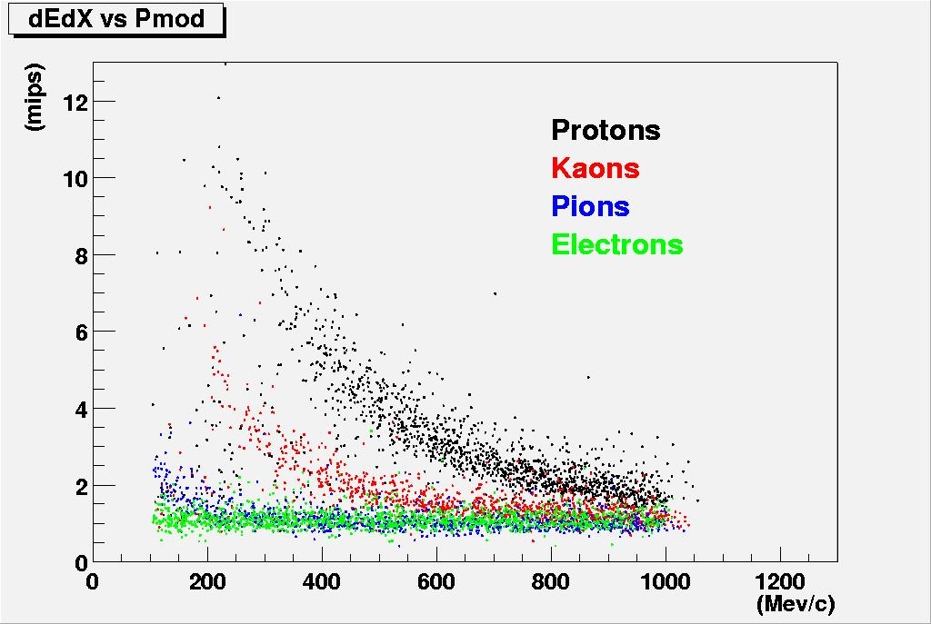
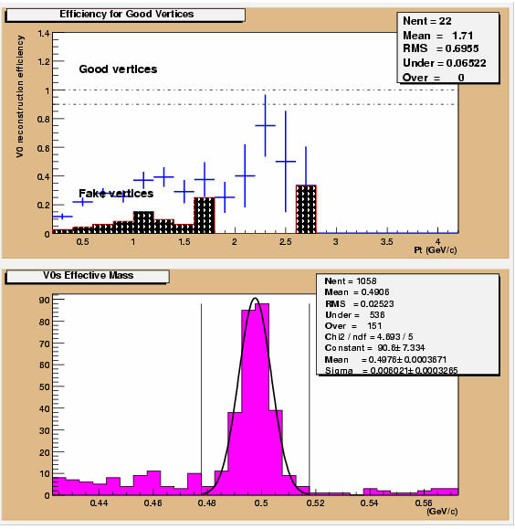
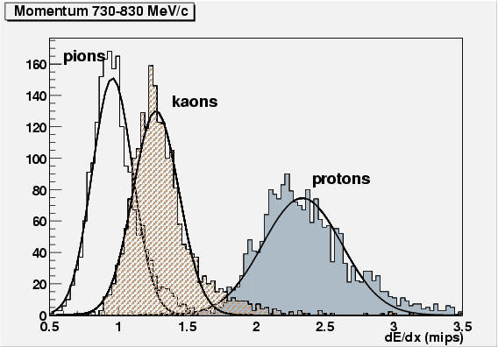
A Data Analysis & Visualisation tool

Slide 29
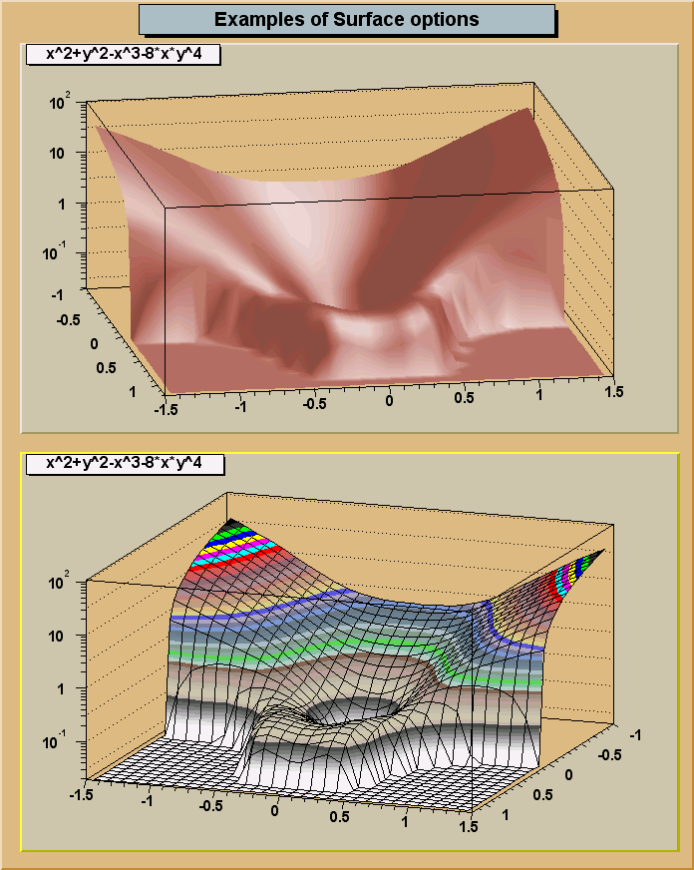
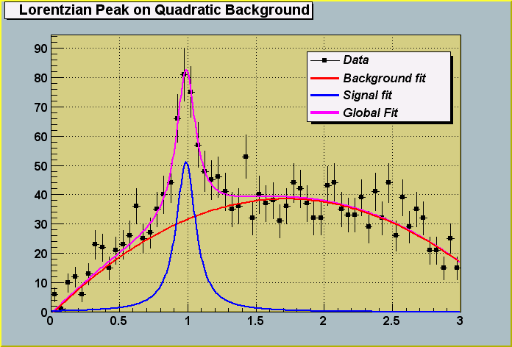
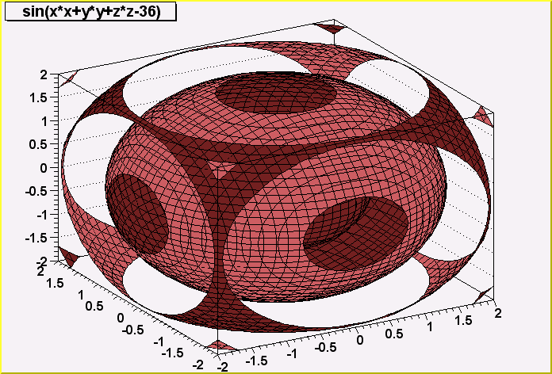
Graphics : 1,2,3-D functions

Slide 30

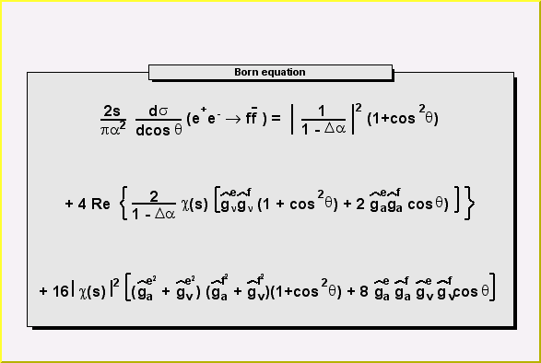

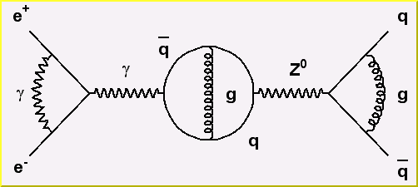
Full LateX support on screen and postscript
Formula or
diagrams can be
edited with the mouse
TCurlyArc
TCurlyLine
TWavyLine
and other building blocks for Feynmann diagrams

Slide 31
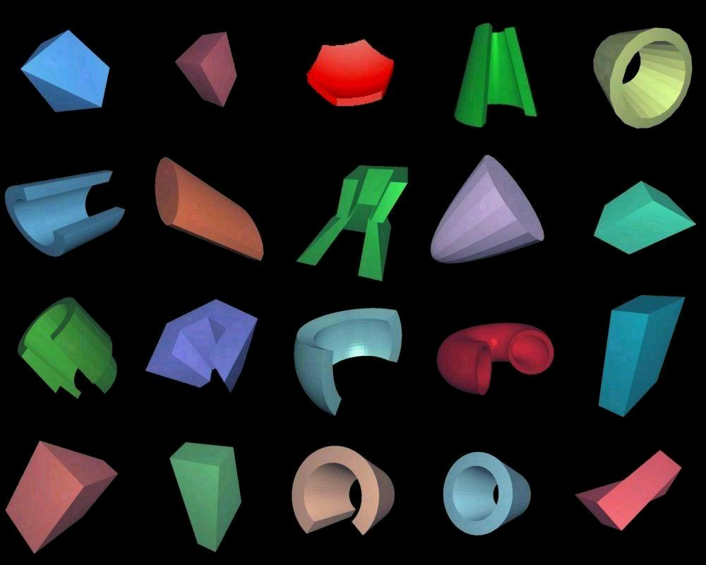
ROOT 3D Graphics
The ROOT basic 3D shapes
Simple Box

Slide 32
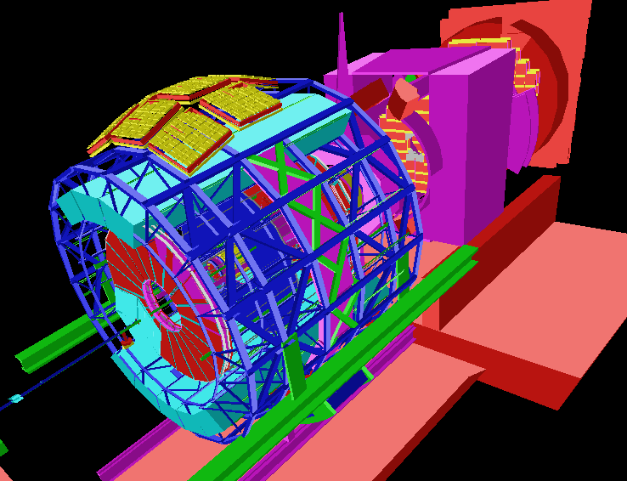
Alice
3 million nodes

Slide 33
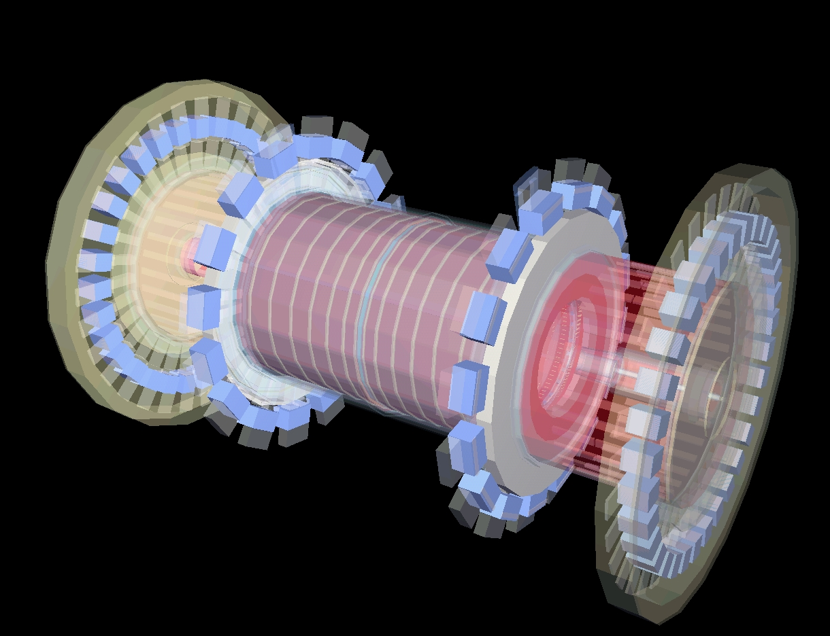
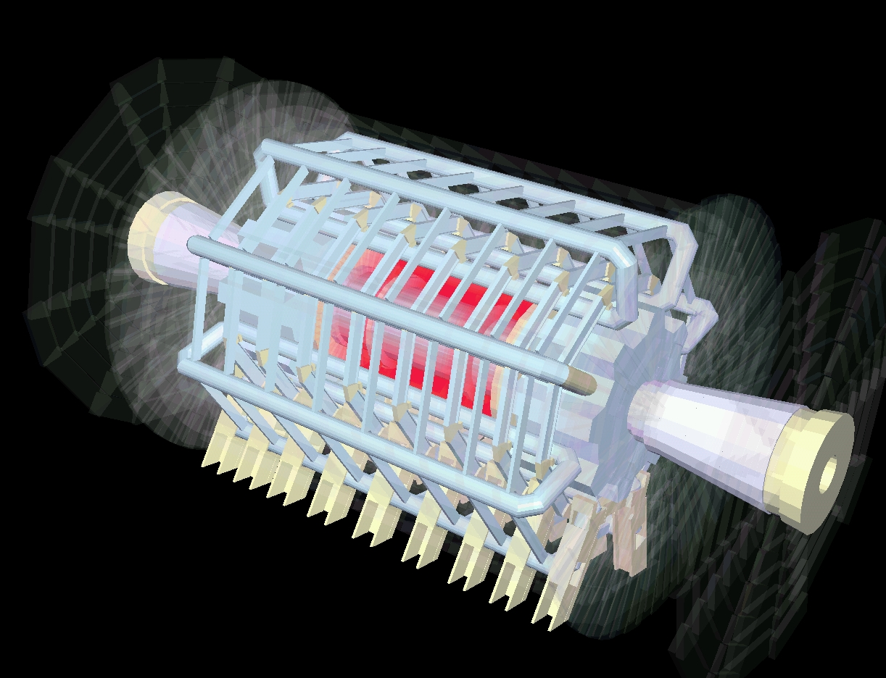
ROOT 3D Graphics
R. Brun (CERN), O. Couet (CERN), M. Gheata (ISS), A. Gheata (ISS), V. Onoutchine (IFVE), T.Pocheptsov (JINR)
Text …………………
Atlas

Slide 34
Input/Output

Slide 35
Data Sets types
Simulated data
10 Mbytes/event
Raw data
1 Mbyte/event
1000 events/data set
A few reconstruction passes
Event Summary Data
Event Summary Data
Event Summary Data
1 Mbyte/event
About 10 data sets for 1 raw data set
Analysis Objects Data
Several analysis groups
Physics oriented
Analysis Objects Data
Analysis Objects Data
Analysis Objects Data
Analysis Objects Data
Analysis Objects Data
100 Kbytes/event

Slide 36
Data Sets Total Volume
Each experiment will take about 1 billion events/year
1 billion events ➔ 1 million raw data sets of 1 Gbyte
===➔10 million data sets with ESDs and AODs
==➔ 100 million data sets with the replica on the GRID
All event data are C++ objects streamed to ROOT files

Slide 37
Relational Data Bases
RDBMS (mainly Oracle) are used in many places and mainly at T0
  for detector calibration and alignment
  for File Catalogs
The total volume is small compared to event data (a few tens of Gigabytes, may be 1 Terabyte)
Often RDBMS exported as ROOT read-only files for processing on the GRID
Because most physicists do not see the RDBMS, I will not describe /mention it any more in this talk.

Slide 38
How did we reach this point
Today’s situation with ROOT + RDBMS was reached circa 2002 when it was realized that an alternative solution based on an object-oriented data base (Objectivity) could not work.
It took us a long time to understand that a file format alone was not sufficient and that an automatic object streaming for any C++ class was fundamental.
One more important step was reached when we understood the importance of self-describing files and automatic class schema evolution.

Slide 39
The situation in the 70s
Fortran programming. Data in common blocks written and read by user controlled subroutines.
Each experiment has his own format. The experiments are small (10 to 50 physicists) with short life time (1 to 5 years).
common /data1/np, px(100),py(100),pz(100)…
common/data2/nhits, adc(50000), tdc(10000)
Experiment non portable format

Slide 40
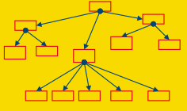
The situation in the 80s
Fortran programming. Data in banks managed by data structure management systems like ZEBRA, BOS writing portable files with some data types description.
The experiments are bigger (100 to 500 physicists) with life time between 5 and 10 years.
ZEBRA portable files

Slide 41
The situation in the 90s
Painful move from Fortran to C++.
Drastic choice between HEP format (ROOT) or a commercial system (Objectivity).
It took more than 5 years to show that a central OO data base with transient object = persistent object and no schema evolution could not work
The experiments are huge (1000 to 2000 physicists) with life time between 15 and 25 years.
ROOT portable and
self-describing files
Central non portable
OO data base

Slide 42
The situation in 2000-a
Following the failure of the OODBMS system, an attempt to store event data in a relational data base fails also quite rapidly when we realized that RDBMS systems are not designed to store petabytes of data.
The ROOT system is adopted by the large US experiments at FermiLab and BNL. This version is based on object streamers specific to each class and generated automatically by a preprocessor.

Slide 43
The situation in 2000-b
Although automatically generated object streamers were quite powerful, they required the class library containing the streamer code at read time.
We realized that this will not fly in the long term as it is quite obvious that the streamer library used to write the data will not likely be available when reading the data several years later.

Slide 44
The situation in 2000-c
A system based on class dictionaries saved together with the data was implemented in ROOT. This system was able to write and read objects using the information in the dictionaries only and did not required anymore the class library used to write the data.
In addition the new reader is able to process in the same job data generated by successive class versions.
This process, called automatic class-schema-evolution proved to be a fundamental component of the system.
It was a huge difference with the OODBMS and RDBMS systems that forced a conversion of the data sets to the latest class version.

Slide 45
The situation in 2000-d
Circa 2000 it was also realized that streaming objects or objects collections in one single buffer was totally inappropriate when the reader was interested to process only a small subset of the event data.
The ROOT Tree structure was not only a Hierarchical Data Format, but was designed to be optimal when
  The reader was interested by a subset of the events, by a subset of each event or both.
  The reader has to process data on a remote machine across a LAN or WAN.
The TreeCache minimizes the number of transactions and also the amount of data to be transferred.

Slide 46
The situation in 2005
Distributed processing on the GRID, but still moving the data to the job.
Very complex object models. Requirement to support all possible C++ features and nesting of STL collections.
Experiments have thousands of classes that evolve with time.
Data sets written across the years with evolving class versions must be readable with the latest version of the classes.
Requirement to be backward compatible (difficult) but also forward compatible (extremely difficult)

Slide 47
Object Persistency
(in a nutshell)
Two I/O modes supported (Keys and Trees).
Key access: simple object streaming mode. A ROOT file is like a Unix directory tree. Very convenient for objects like histograms, geometries, mag.field, calibrations
Trees
  A generalization of ntuples to objects. Designed for storing events
  split and no split modes
  query processor
Chains: Collections of files containing Trees
ROOT files are self-describing
Interfaces with RDBMS also available
Access to remote files (RFIO, DCACHE, GRID)

Slide 48
I/O
Object in Memory
sockets
Net File
Buffer
Web File
http
XML File
XML
Streamer:
No need for
transient / persistent classes
DataBase
SQL
Local
File on
disk

Slide 49
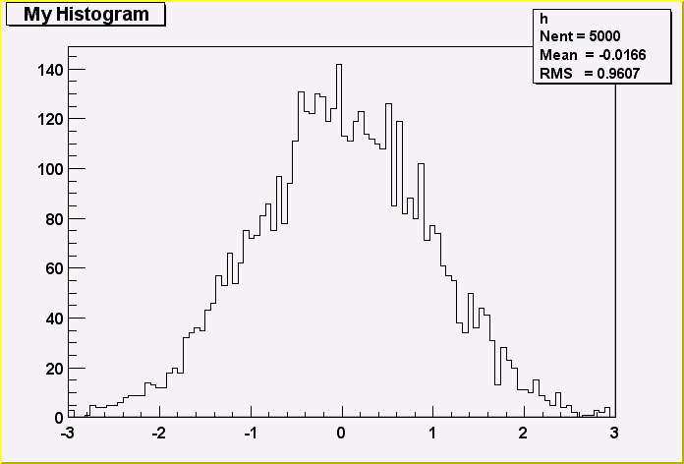
ROOT I/O : An Example
Writer
demoh.C
TFile f(“example.root”,”new”);
TH1F h(“h”,”My histogram”,100,-3,3);
h.FillRandom(“gaus”,5000);
h.Write();
Reader
demohr.C
TFile f(“example.root”);
TH1F *h = (TH1F*)f.Get(“h”):
h->Draw();
f.Map();
20010831/171903 At:64 N=90 TFile
20010831/171941 At:154 N=453 TH1F CX = 2.09
20010831/171946 At:607 N=2364 StreamerInfo CX = 3.25
20010831/171946 At:2971 N=96 KeysList
20010831/171946 At:3067 N=56 FreeSegments
20010831/171946 At:3123 N=1 END

Slide 50
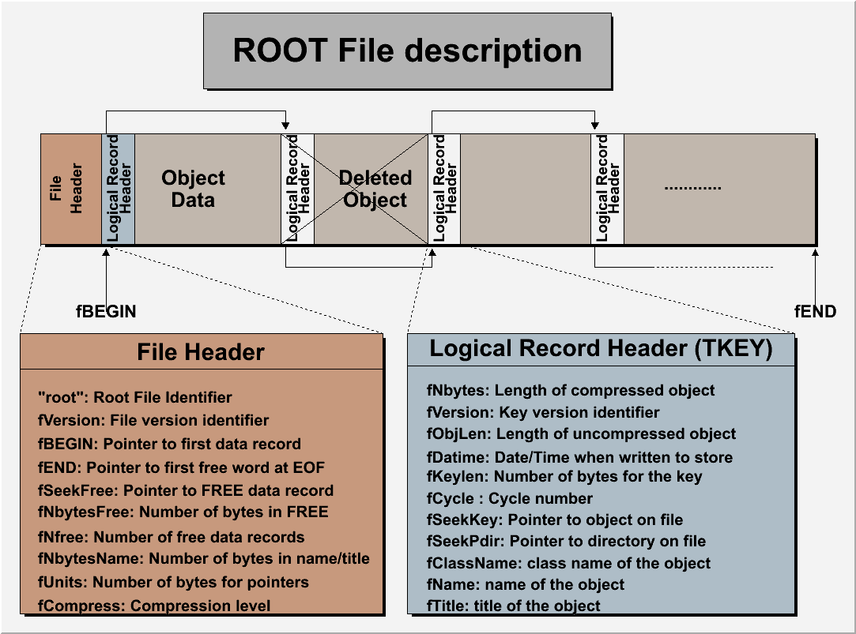
ROOT file structure

Slide 51

Objects in directory
/pippa/DM/CJ
eg:
/pippa/DM/CJ/h15
A ROOT file pippa.root
with 2 levels of
sub-directories

Slide 52
File types & Access
user
Local
File
X.xml
TFile
TKey/TTree
TStreamerInfo
TTreeSQL
TSQLServer
TSQLRow
TSQLResult
http
rootd/xrootd
Oracle
Local
File
X.root
Dcache
Castor
MySQL
PgSQL
hadoop
Chirp
SapDb

Slide 53
Self-describing files
Dictionary for persistent classes written to the file.
ROOT files can be read by foreign readers
Support for Backward and Forward compatibility
Files created in 2001 must be readable in 2015
Classes (data objects) for all objects in a file can be regenerated via TFile::MakeProject
Root >TFile f(“demo.root”);
Root > f.MakeProject(“dir”,”*”,”new++”);

Slide 54
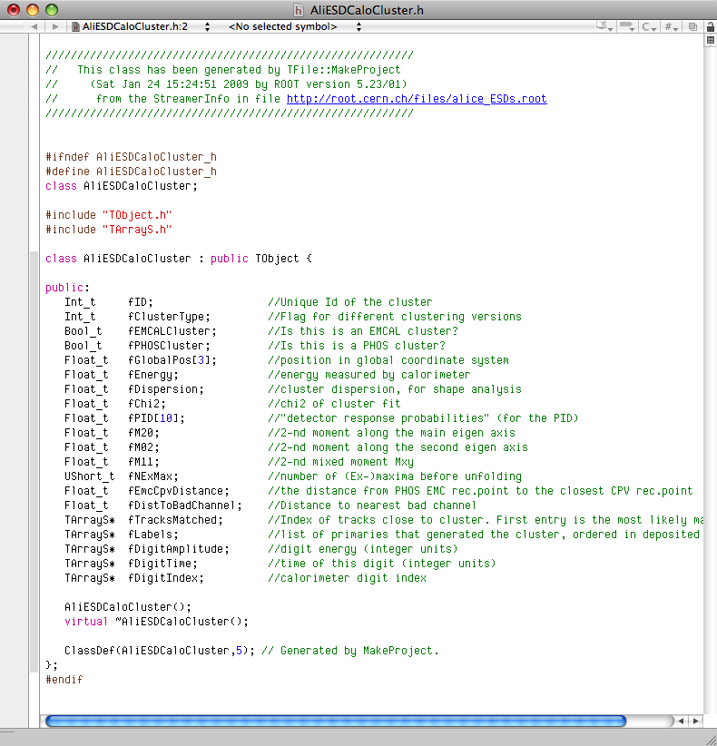
TFile::MakeProject
Generate C++ header files
and shared lib for the classes in file
(macbrun2) [253] root -l
root [0] TFile *falice = TFile::Open("http://root.cern.ch/files/alice_ESDs.root");
root [1] falice->MakeProject("alice","*","++");
MakeProject has generated 26 classes in alice
alice/MAKEP file has been generated
Shared lib alice/alice.so has been generated
Shared lib alice/alice.so has been dynamically linked
root [2] .!ls alice
AliESDCaloCluster.h AliESDZDC.h AliTrackPointArray.h
AliESDCaloTrigger.h AliESDcascade.h AliVertex.h
AliESDEvent.h AliESDfriend.h MAKEP
AliESDFMD.h AliESDfriendTrack.h alice.so
AliESDHeader.h AliESDkink.h aliceLinkDef.h
AliESDMuonTrack.h AliESDtrack.h aliceProjectDict.cxx
AliESDPmdTrack.h AliESDv0.h aliceProjectDict.h
AliESDRun.h AliExternalTrackParam.h aliceProjectHeaders.h
AliESDTZERO.h AliFMDFloatMap.h aliceProjectSource.cxx
AliESDTrdTrack.h AliFMDMap.h aliceProjectSource.o
AliESDVZERO.h AliMultiplicity.h
AliESDVertex.h AliRawDataErrorLog.h
root [3]

Slide 55

ROOT Trees
The bulk data containers

Slide 56
Memory <--> Tree
Each Node is a branch in the Tree
Memory
0
T.GetEntry(6)
1
2
3
4
5
6
7
8
9
10
11
12
13
14
15
16
17
T.Fill()
18
T
tr

Slide 57
Tree example Event (write)
All the examples
can be executed
with CINT
or the compiler
root > .x demoe.C
root > .x demoe.C++
void demoe(int nevents) {
//load shared lib with the Event class
gSystem->Load("$ROOTSYS/test/libEvent");
//create a new ROOT file
TFile f("demoe.root",”new");
//Create a ROOT Tree with one single top level branch
Event *event = new Event;
TTree T("T","Event demo tree");
T.Branch("event”,&event,bufsize);
//Build Event in a loop and fill the Tree
for (int i=0;i<nevents;i++) {
event->Build(i);
T.Fill();
}
T.Write(); //Write Tree header to the file
}

Slide 58
Tree example Event (read 1)
void demoer() {
//load shared lib with the Event class
gSystem->Load("$ROOTSYS/test/libEvent");
//connect ROOT file
TFile *f = new TFile("demoe.root");
//Read Tree header and set top branch address
Event *event = 0;
TTree *T = (TTree*)f->Get("T");
T->SetBranchAddress("event",&event);
//Loop on events and fill an histogram
TH1F *h = new TH1F("hntrack","Number of tracks",100,580,620);
int nevents = (int)T->GetEntries();
for (int i=0;i<nevents;i++) {
T->GetEntry(i);
h->Fill(event->GetNtrack());
}
h->Draw();
}
Rebuild the full event
in memory

Slide 59
ROOT I/O -- Split/Cluster
Tree version
Tree entries
Streamer
Branches
Tree in memory
File

Slide 60
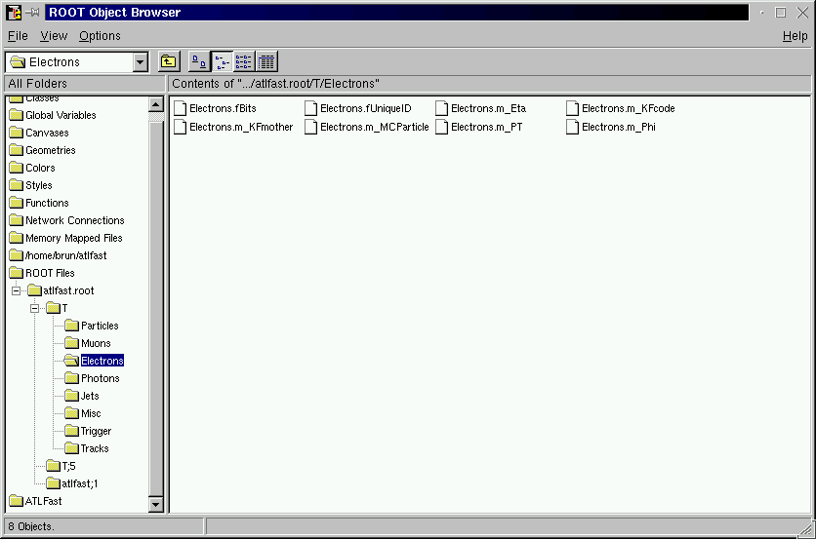
Browsing a TTree with TBrowser
8 leaves of branch
Electrons
A double click
To histogram
The leaf
8 branches of T

Slide 61
Data Volume & Organization
100MB
1GB
10GB
100GB
1TB
10TB
100TB
1PB
1
1
5
50
500
5000
50000
TTree
TChain
A TFile typically contains 1 TTree
A TChain is a collection of TTrees or/and TChains
A TChain is typically the result of a query to the file catalogue

Slide 62
Queries to the data base
via the GUI (TBrowser of TTreeViewer)
via a CINT command or a script
  tree.Draw(“x”,”y<0 && sqrt(z)>6”);
  tree.Process(“myscript.C”);
via compiled code
  chain.Process(“myselector.C+”);
in parallel with PROOF

Slide 63
PROOF and GRID(s) interface

Slide 64
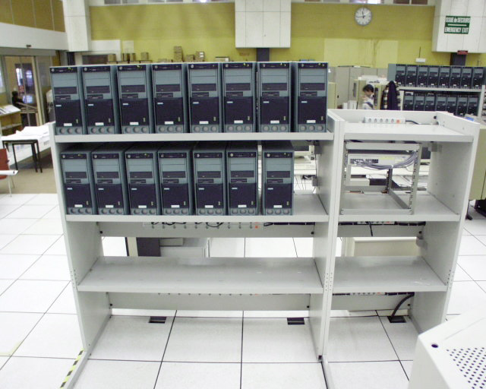
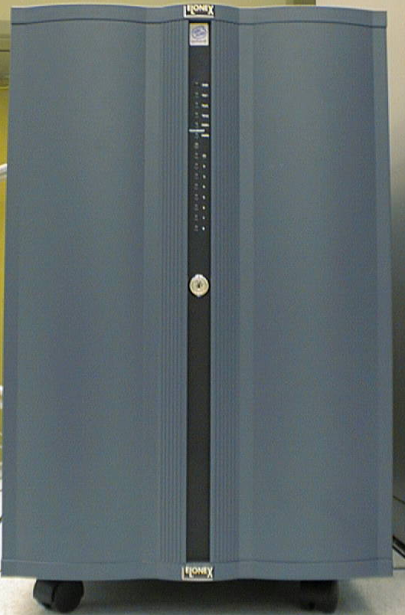
Parallelism everywhere
What about this picture in the very near future?
file
catalogue
Local cluster
Remote clusters
1000x32 cores
32 cores
Cache
1 PByte
Cache
1TByte

Slide 65





Traditional Batch Approach
Job splitter
File catalog
Batch cluster
Job
Split analysis job in N
stand-alone sub-jobs
Storage
Job
Queue
Query
Job
Job
Job
Job
Job
Job Merger
Job
Collect sub-jobs and
merge into single output
CPU’s
Job
Job
Job
Batch
Scheduler
Job
Split analysis task in N batch jobs
Job submission sequential
Very hard to get feedback during processing
Analysis finished when last sub-job finished

Slide 66
The PROOF Approach
File catalog
PROOF cluster
Storage
Query
PROOF query:
data file list, mySelector.C
Scheduler
CPU’s
Feedback,
merged final output
Master
Cluster perceived as extension of local PC
Same macro and syntax as in local session
More dynamic use of resources
Real-time feedback
Automatic splitting and merging

Slide 67
Summary
The ROOT system is the result of 15 years of cooperation between the development team and thousands of heterogeneous users.
ROOT is not only a file format, but mainly a general object I/O storage and management designed for rapid data analysis of very large shared data sets.
It allows concurrent access and supports parallelism in a set of analysis clusters (LAN and WAN).

